Slide 1

e-Cut Pitch Deck
Hair services at your fingertips

Slide 2

Problem
‘Empty chairs’ cost salons rent, heat and light.
Hair salons often change stylists, and there is no possibility to book the favorited ones, unless specifically agreed in advance.
No easy way exists to book, within a matter of seconds, a hair stylists that would provide a service at a chosen address, anytime during the day.

Slide 3



Solution
JustEat/Airbnb for Hair: Benefiting Salons, stylists and clients
Designed to exploit salon down time, and Stylist Over-Capacity
Save time, When getting a service
Make money, when providing a service

Slide 4




Market Size
THERE ARE 40,000 hairdressing, barbering and beauty businesses in the UK
THE HAIRDRESSING, BARBERING AND BEAUTY INDUSTRY generates almost £7bn in turnover each year
300,000 PEOPLE work in the hairdressing, barbering and beauty industry
46.4 MILLIONS of smartphone users in the UK, which all require haircare from time to time

Slide 5
Business Model
We take a 10% commission on each transaction
46.4m
0,05%
£20
£1.8M
Of smartphone users in the UK (2017)*
Percentage of users target by 2019
Average transaction = £2 average fee
Revenue projected by 2019 when a service from each registered user is booked once every 6 months.
*https://www.statista.com/statistics/270821/smartphone-user-in-the-united-kingdom-uk/

Slide 6






Market Adoption
Online presence:
Offline presence:
Direct contact with future users
Leafleting
Events (Free haircuts near busy centers)
Promotional Mails
Partnership with other on-demand apps
Email marketing
Social Media advertising
Google Ads
Search Engine Optimization
2,5K
3K
3,3K
1,2K (Clients)

Slide 7


Competition
GetSmooth: Send a “random” stylist.
Web platform only, Mobile App not available.
Offer 4 services. Only for men.
Priv: Similar features as e-Cut but don’t allow the same flexibility to their employees. Also very expensive compared to the average e-Cut services price.
Blow LTD: Expensive. Provide Services for women only.
RUUBY: Focused on services for women only.

Slide 8




Competitive Advantage
First to market for App transaction based hairstyle booking services and “delivery” of Hair care services
Professional incentive:
Hair Salons will have extra revenue.
Single Pros will work as self-employed on Full/Part-time basis
Profiles: Browse Professional’s/Salon’s profiles and book in a few clicks.
High competition between stylists: decrease costs for clients
Similar successful business model to Airbnb, JustEat and Fiverr

Slide 9
Team
Advisor
Andrew c.
Founder/CEO
Mentor for worldwide tech businesses such as: WorldPay & Blinkbox. Degrees in economics and law.
Qualified Lawyer and PMI of 20+ years of experience.
Developer/CTO
James M.
Tommaso N.
IOS, Android and Web developer SEO and monetization Expert Experience in on-demand Apps
Developed British Army Apps and software used in 90% of Irish pharmacies.
5 Years in e-Commerce. Online sales expert. Online Marketing Enthusiast. Degree in e-Commerce and Business management
Service quality supervisor
Vittorio M.
Italian Hairdresser/Barber with 25 years of experience. Management skills Owner of 2 Hair Salons

Slide 10
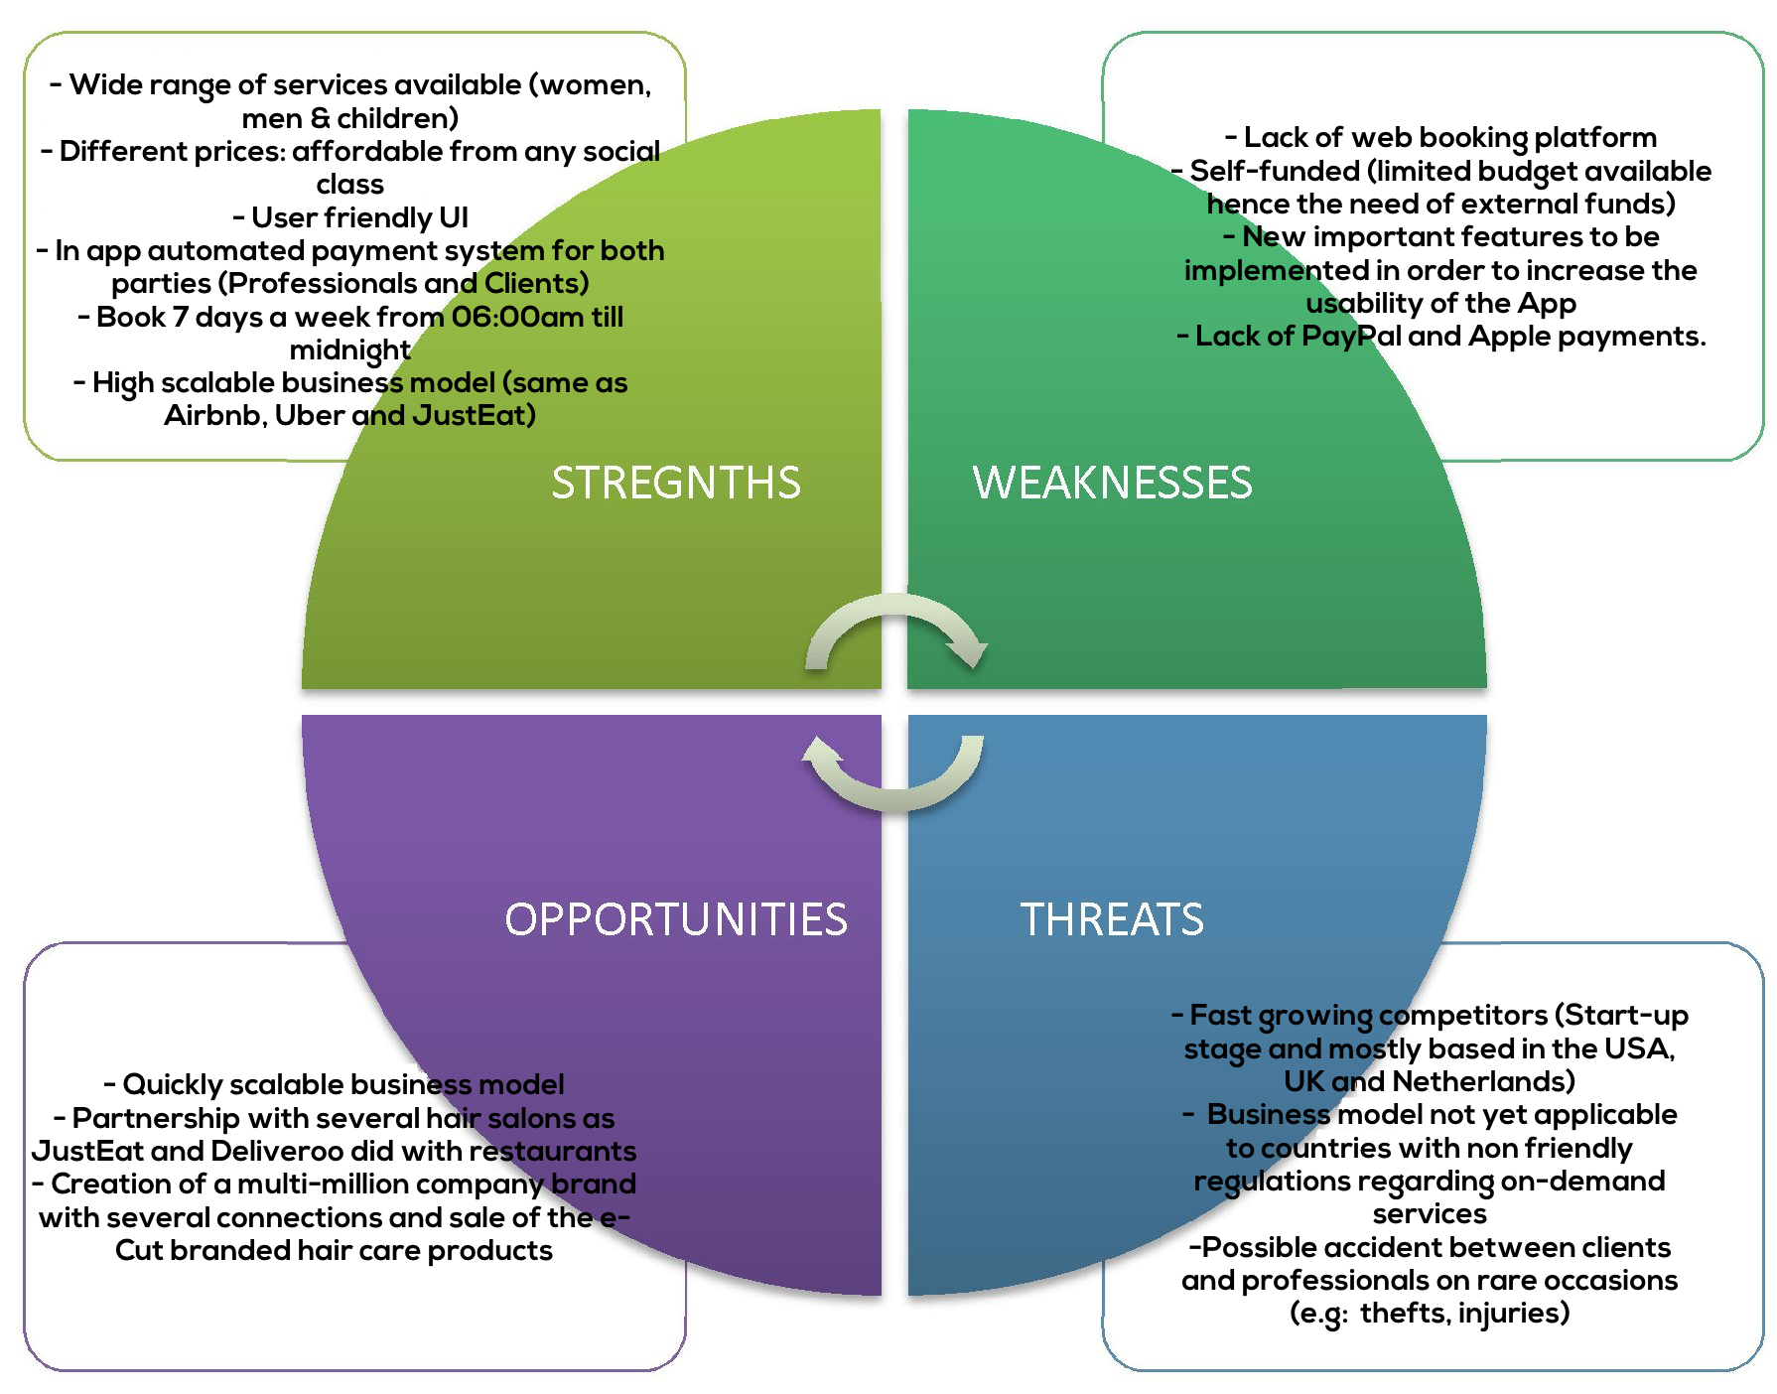
S.W.O.T Analysis

Slide 11
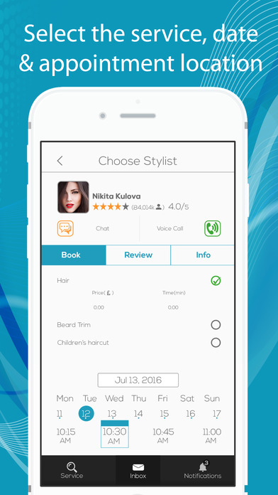
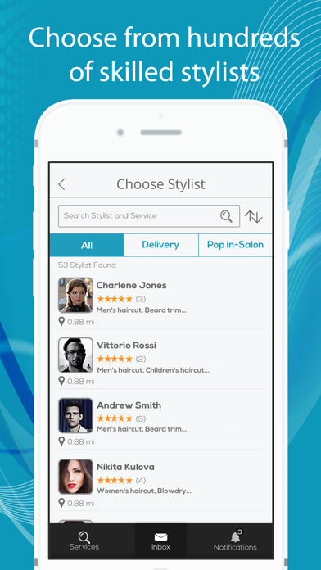
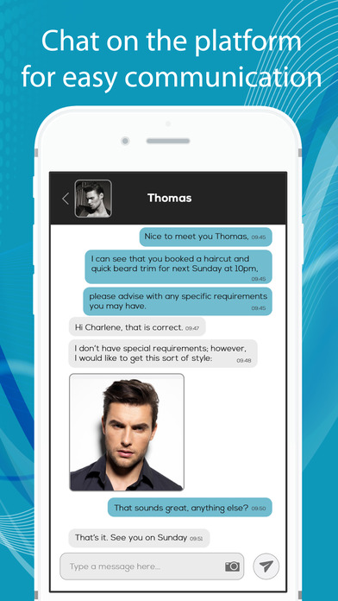
The App

Slide 12

Financial
We are looking for a first investment to fund wider marketing campaigns, hire staff, develop a web platform and implement new features on the Mobile App.
£190K
Investment needed

